Slide 1
Web Application Development ISCG7420 Introduction to Web Development
School of Computing, Electrical and Applied Technology

Slide 2
Outlines – Simple Blog
Many to Many Relationships
Extended Registration Form
Rich Text Editor
Snippet
Profile
Change Password
Upload Images

Slide 3
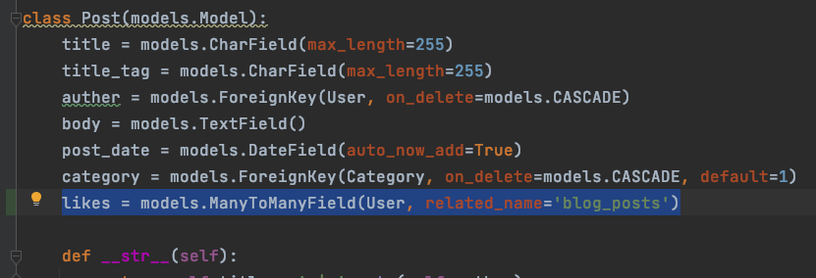
Add a likes to Model Post
makemigrations & migrate

Slide 4
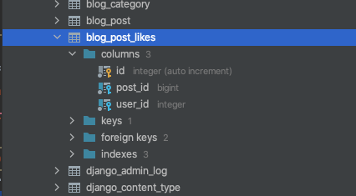
Check your database

Slide 5
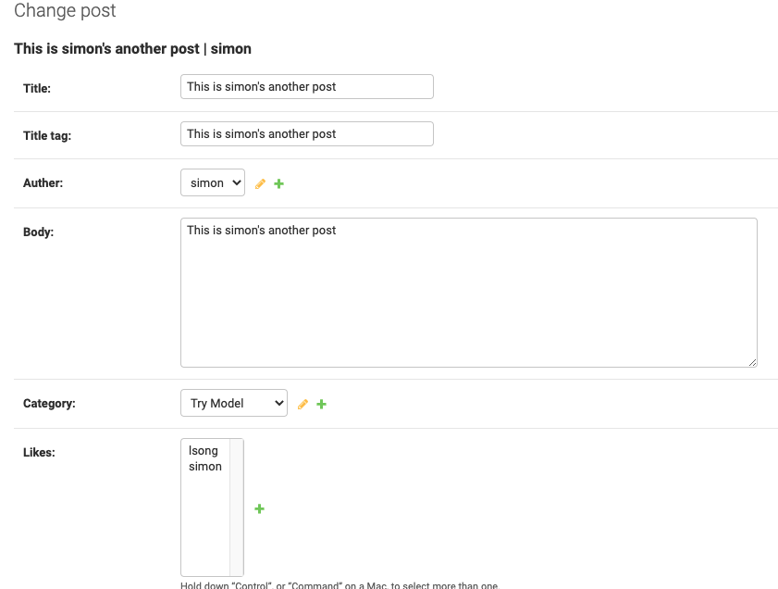
Check from your admin site

Slide 6
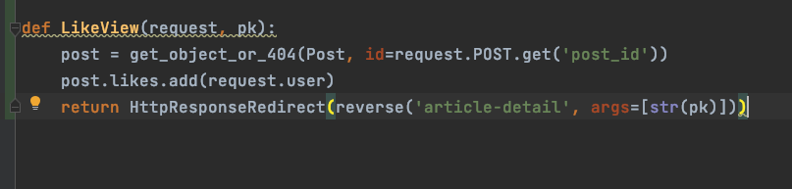
Views

Slide 7
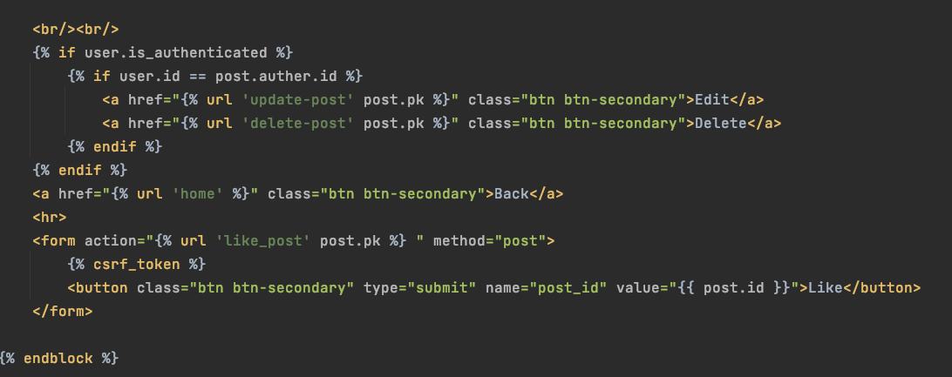
Template
In article-detail.html

Slide 8

Create a function to count total likes
In Model Post

Slide 9
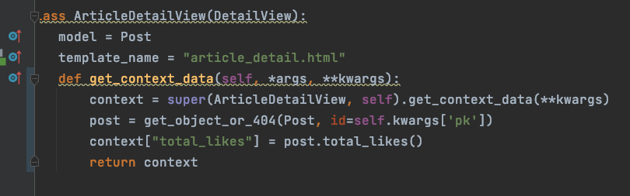
Views

Slide 10
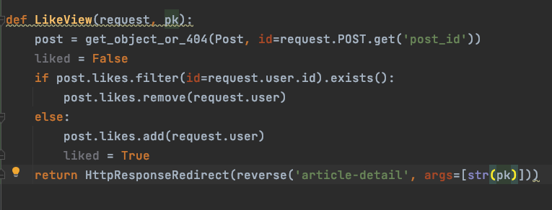
Add Unlike to remove from DB

Slide 11
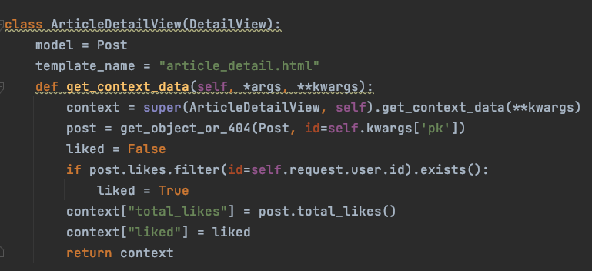
Add liked to context

Slide 12
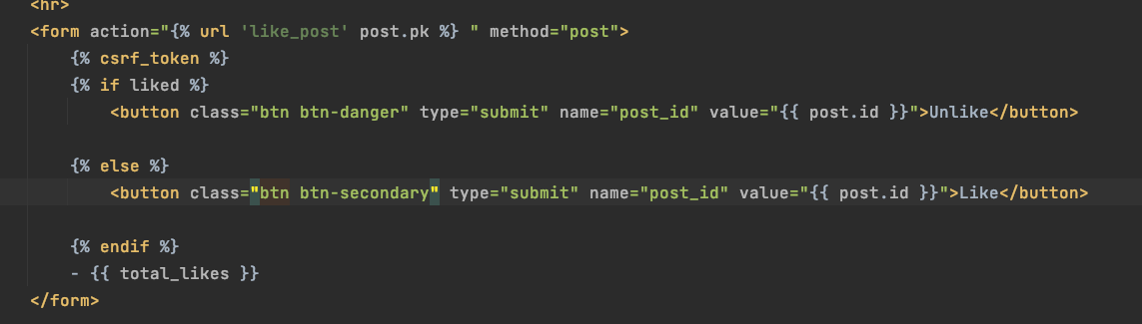
Create another button for unlike
article-detail page

Slide 13
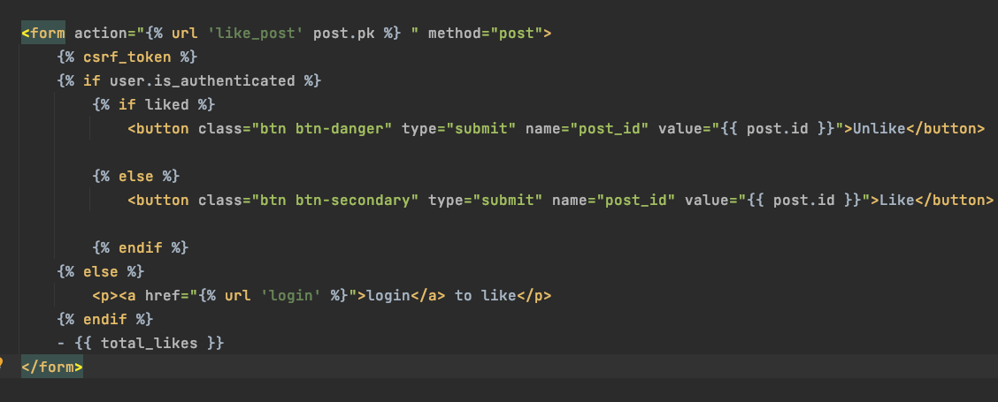
Only authenticated user can click

Slide 14
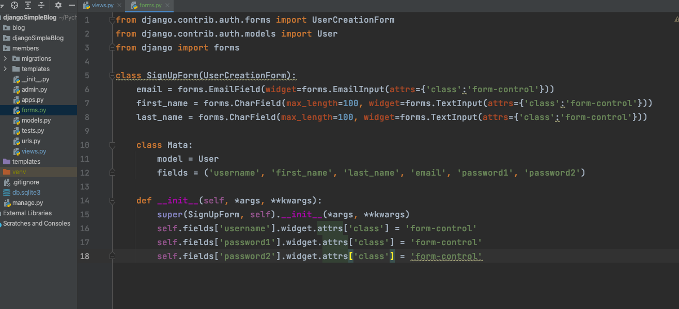
Extended Registration Form
We want first name, last name and email
Create forms in members folder

Slide 15
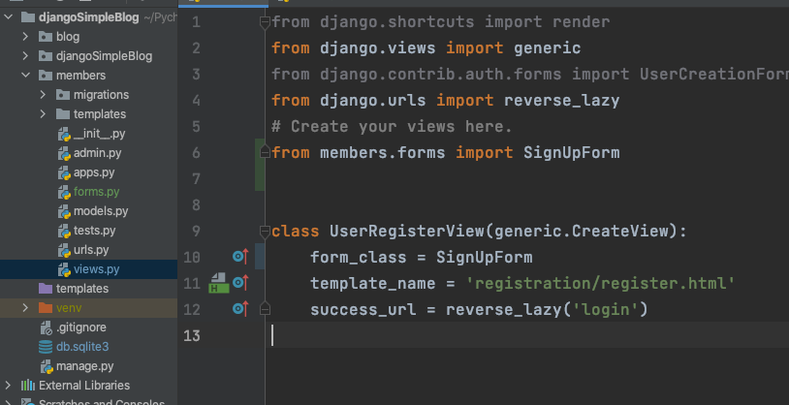
Change the sign up view

Slide 16
Widgets class
https://docs.djangoproject.com/en/3.2/ref/forms/widgets/

Slide 17
Rich Text Editor
Django CKEditor
https://django-ckeditor.readthedocs.io/en/latest/#usage
Type:
pip install django-ckeditor
In terminal

Slide 18
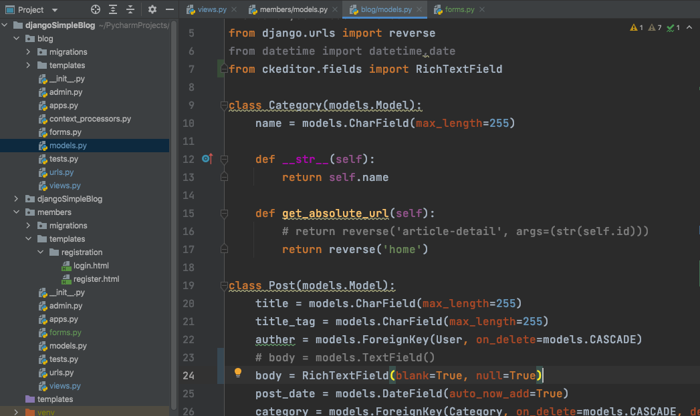
Change body type to RichTextField
makemigrations & migrate

Slide 19
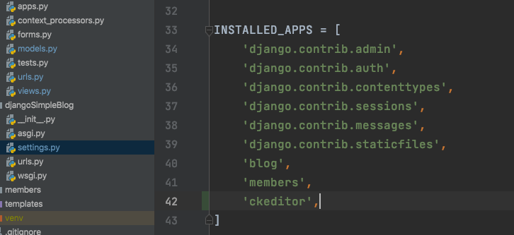
Register ckeditor to settings

Slide 20
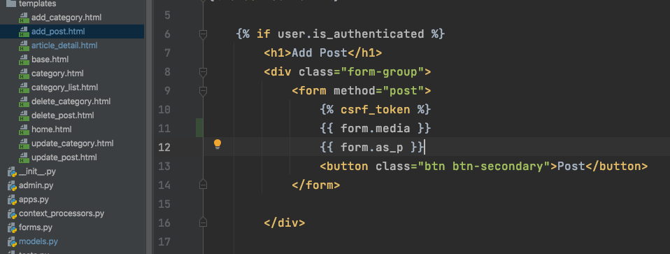
Add form Media to add post page
Same to update post page

Slide 21
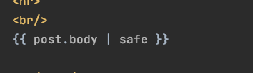
Try take this off from post detail page

Slide 22
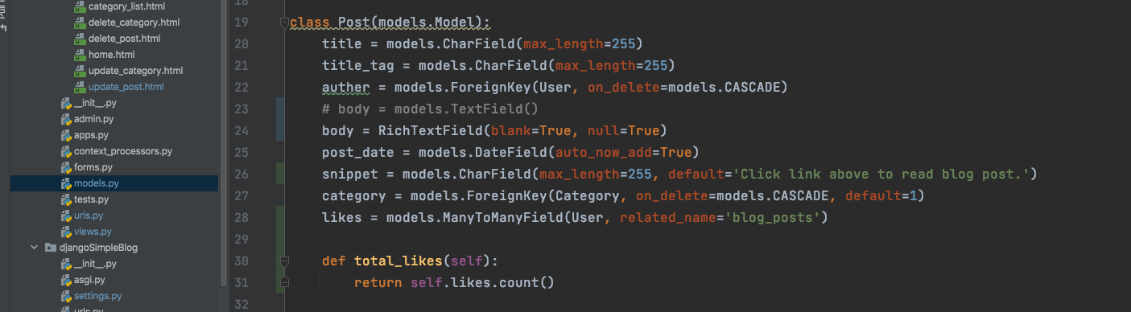
snippet
Formatting your post list page
makemigrations & migrate

Slide 23
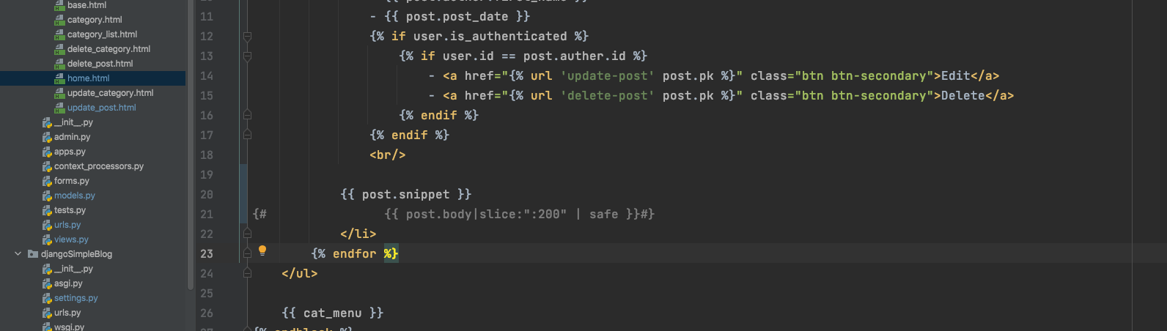
In home.html

Slide 24
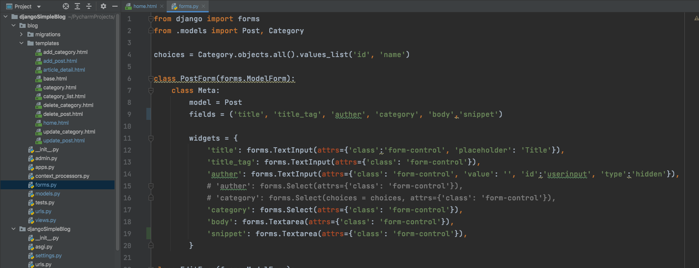
Add snippet to forms create and update form

Slide 25
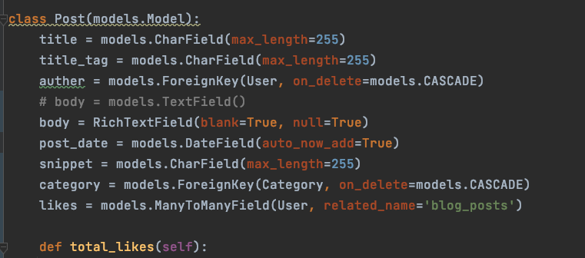
Remove default value for snippet

Slide 26
User Change Form

Slide 27
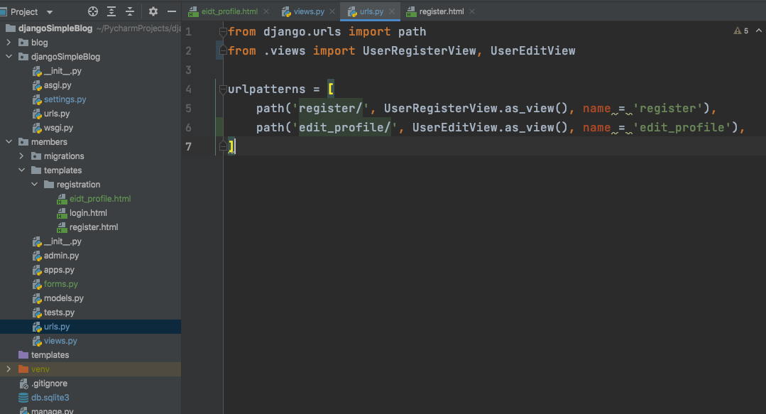
Register new view to urls

Slide 28
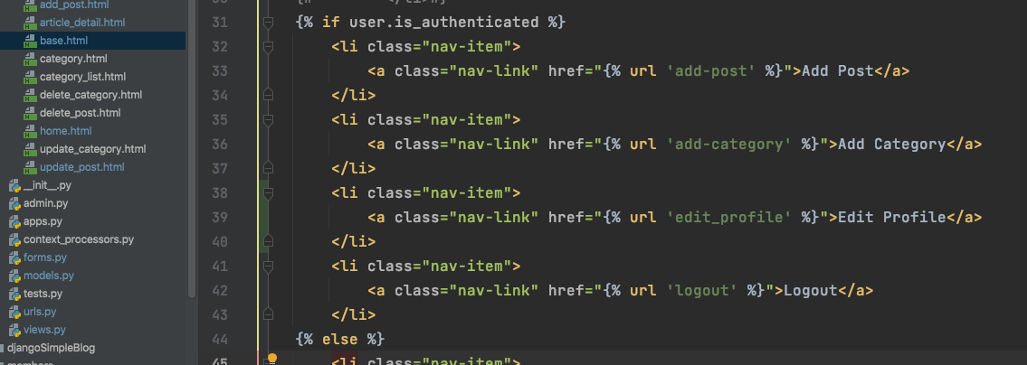
Add new url to base.html

Slide 29
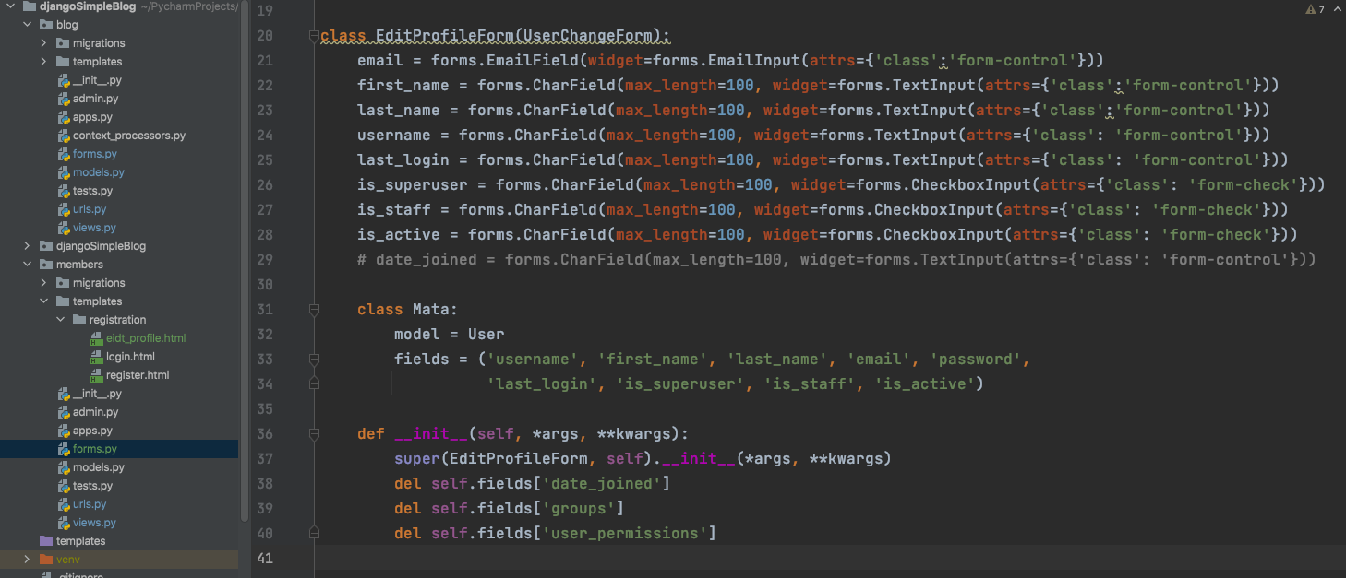
Customize UserChangeForm

Slide 30
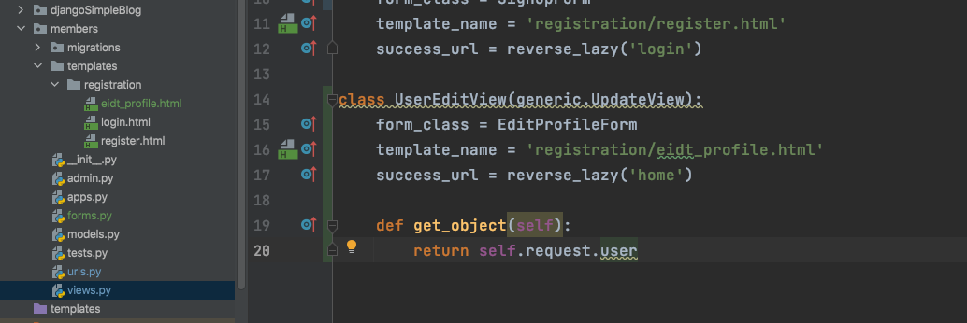
Change form class for UserEditView

Slide 31
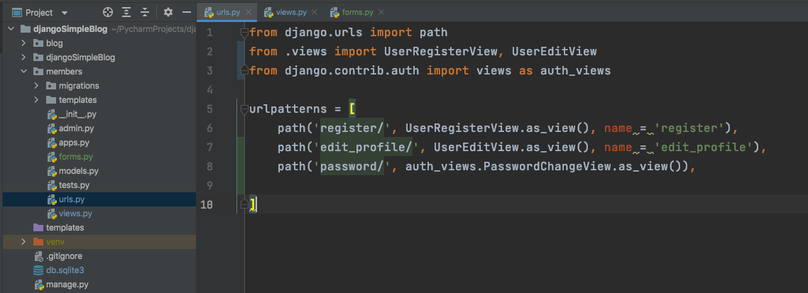
Auth View

Slide 32
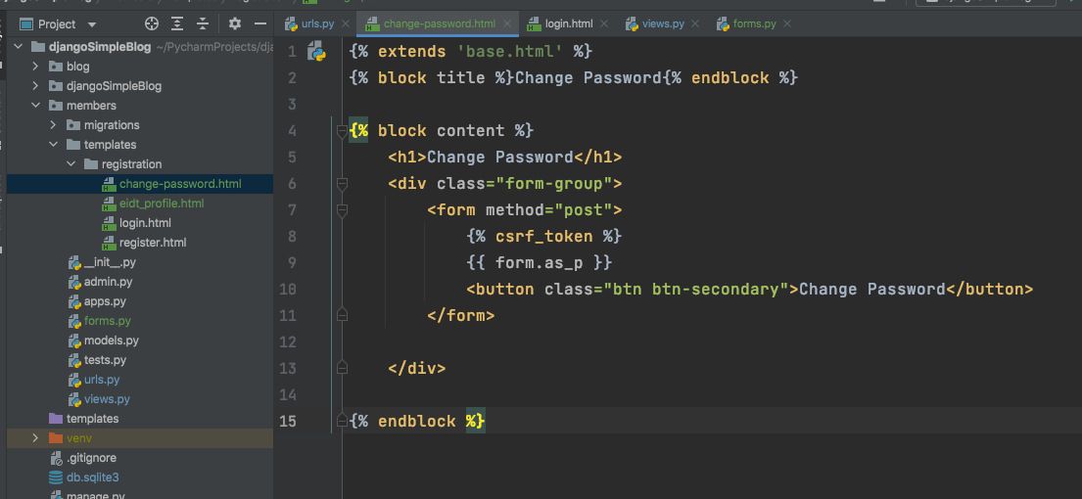
Create a template for change password page

Slide 33
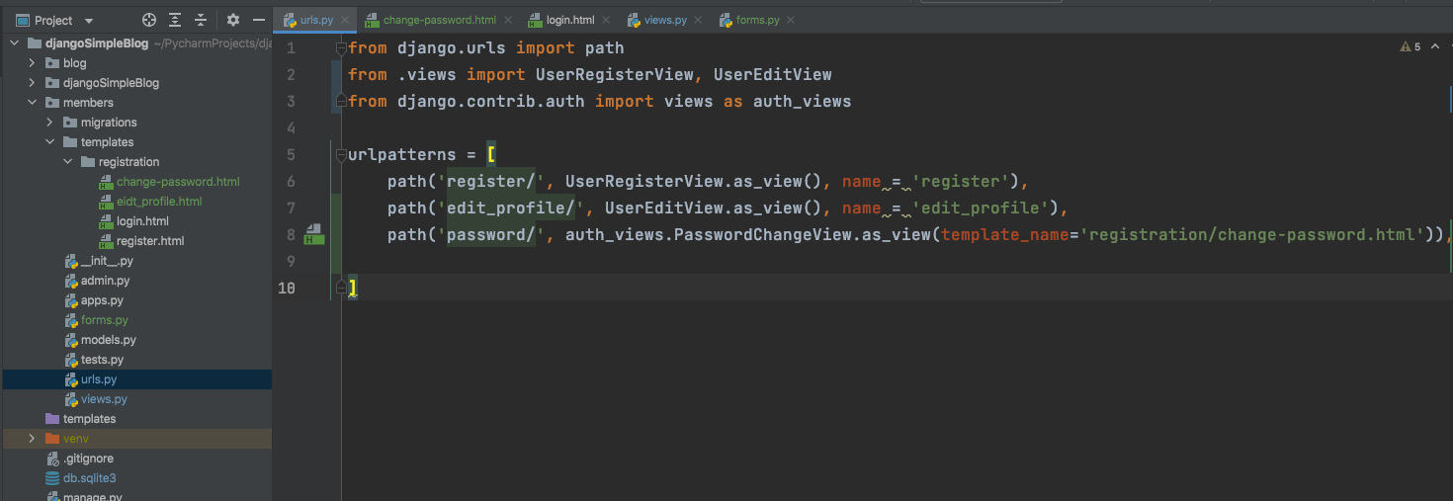
Add template to auth view

Slide 34
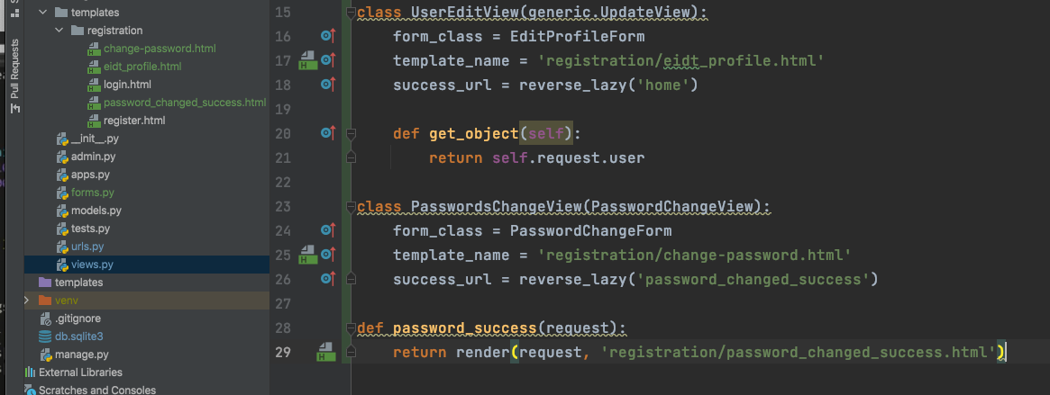
Create a better view

Slide 35
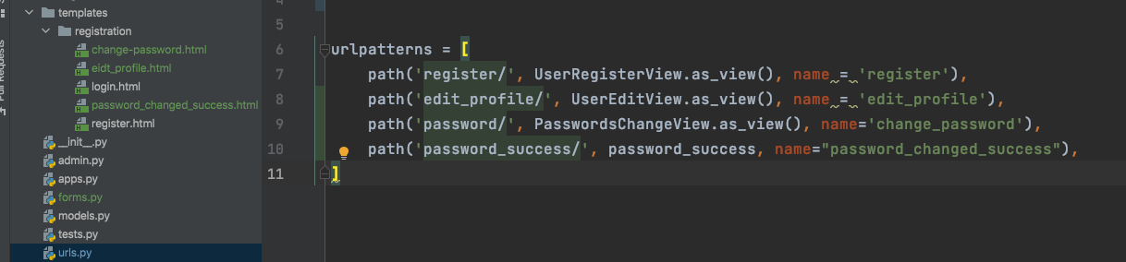
Register a new url

Slide 36
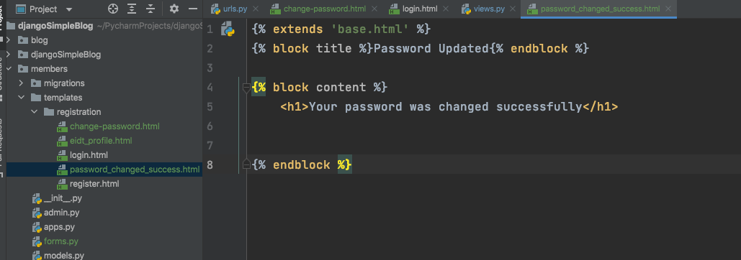
Create a password changed success page

Slide 37
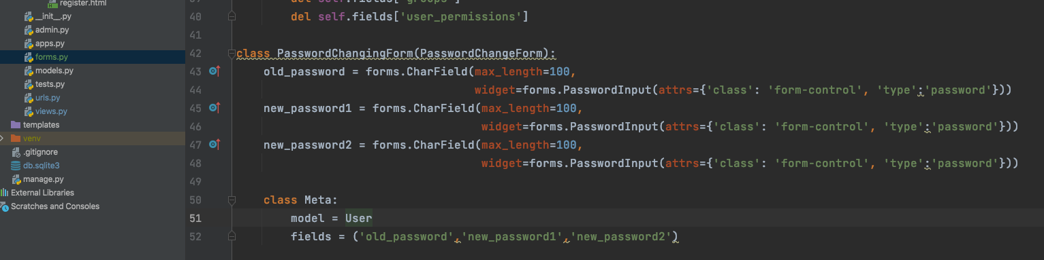
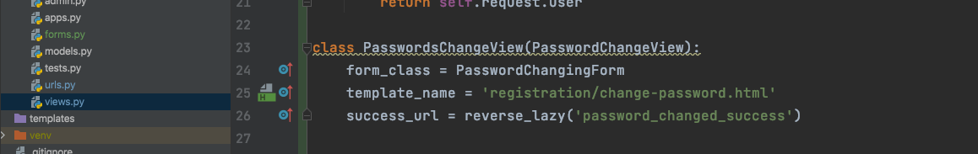
Or, you can create a form

Slide 38
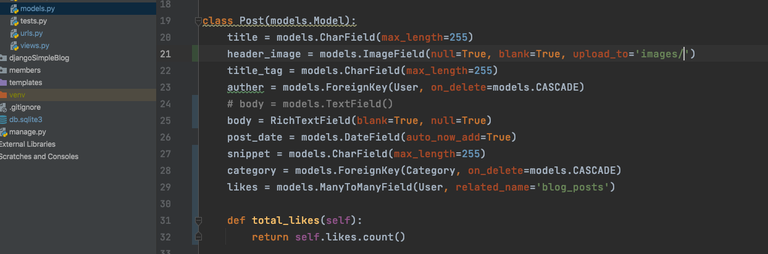
Create image field for Model Post
python -m pip install Pillow
makemigrations & migrate

Slide 39
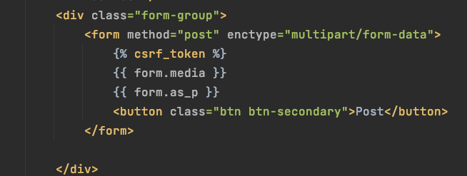
Add Post file -> change form encryption type

Slide 40
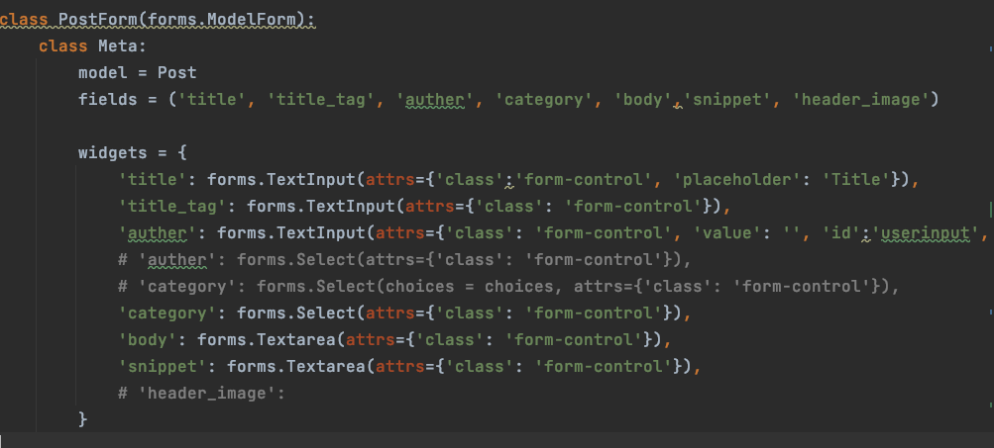
forms.py

Slide 41
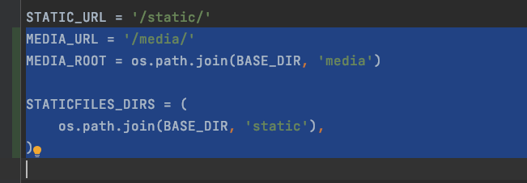
setting.py

Slide 42
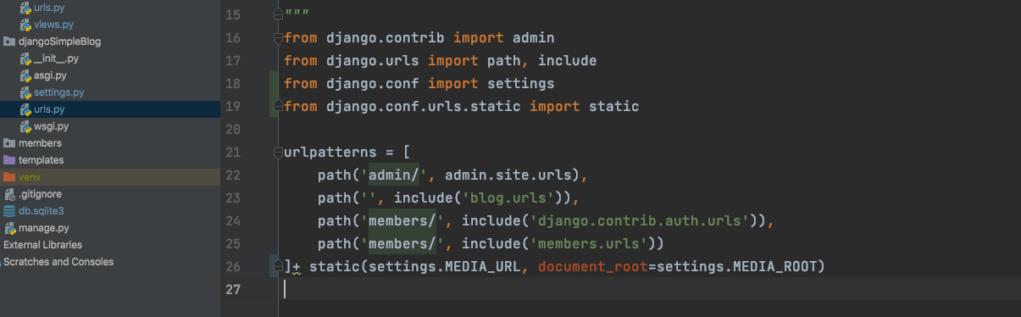
urls.py in app root directory

Slide 43
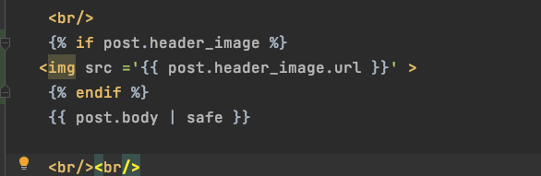
Add image to post detail page

Slide 44
Source
https://www.youtube.com/watch?v=ygzGr51dbsY&list=PLCC34OHNcOtr025c1kHSPrnP18YPB-NFi&index=26&ab_channel=Codemy.com
18-26

